Slide 1


5.1 Introduction to jQuery
- Javascript Library
Lavanya Seetharaman
Instructor@BoardInfinity

Slide 2

jQuery is not a framework
$ is simply an alias for jQuery
$ John Resig in early 2005
$ jQuery is a fast, lightweight.
$ Feature-rich JavaScript library that is based on the principle "write less, do more".
$ Ajax based application.
Obtain the latest version of jQuery https://jquery.com/
Installing jQuery is as easy as placing it within your web application and using the HTML <script> tag to include it in your pages, like this:
<script type="text/javascript" src="scripts/jquery-1.4.js"></script>
<script src="https://code.jquery.com/jquery-3.6.0.min.js" integrity="sha256-/xUj+3OJU5yExlq6GSYGSHk7tPXikynS7ogEvDej/m4=" crossorigin="anonymous"></script>
https://code.jquery.com/ CDN

Slide 3
What you can do with jQuery
$(document).ready(function(){
alert("Hello World!");
$("#blackBox").hide();
});
select elements to perform manipulation.
manipulate DOM elements and their attributes.
implement Ajax to enable asynchronous data exchange between client and server.
traverse all around the DOM tree to locate any element.
perform multiple actions on an element with a single line of code.
create complex CSS animation with fewer lines of code.
window.addEventListener("load", () => {
alert("Hello World!");
document.getElementById("blackBox").style.display = "none";
});
How to use jQuery inside my javascript
$(selector).action()
window.onload = function() {
alert("Hello World!");
document.getElementById("blackBox").style.display = "none";
};
Will call jQuery to select selector elements
Assign it to event

Slide 4
5.2 jQuery Selectors
- Javascript Library
Lavanya Seetharaman
Instructor@BoardInfinity

Slide 5
jQuery Selectors
$("p") → Element Selector
$("#idname") → #id Selector
$(".className") → .class Selector
$(selector).click(function (e) {
// write your code
});
jQuery – Attributes
Get Content
$("input[name='first_name']").val();
$("input[name='last_name']").val();
$("input[name='email']").val();
$("input[name='phone']").val();
text() - Sets or returns the text content of selected elements
html() - Sets or returns the content of selected elements (including HTML markup)
val() - Sets or returns the value of form fields

Slide 6
jQuery Add Elements
jQuery Manipulating CSS
append() - Inserts content at the end of the selected elements
prepend() - Inserts content at the beginning of the selected elements
after() - Inserts content after the selected elements
before() - Inserts content before the selected elements
addClass() - Adds one or more classes to the selected elements
removeClass() - Removes one or more classes from the selected elements
toggleClass() - Toggles between adding/removing classes from the selected elements
css() - Sets or returns the style attribute
jQuery – Remove Elements
remove() - Removes the selected element (and its child elements)
empty() - Removes the child elements from the selected element
DOM Manipulation
Notes:
https://oscarotero.com/jquery/

Slide 7
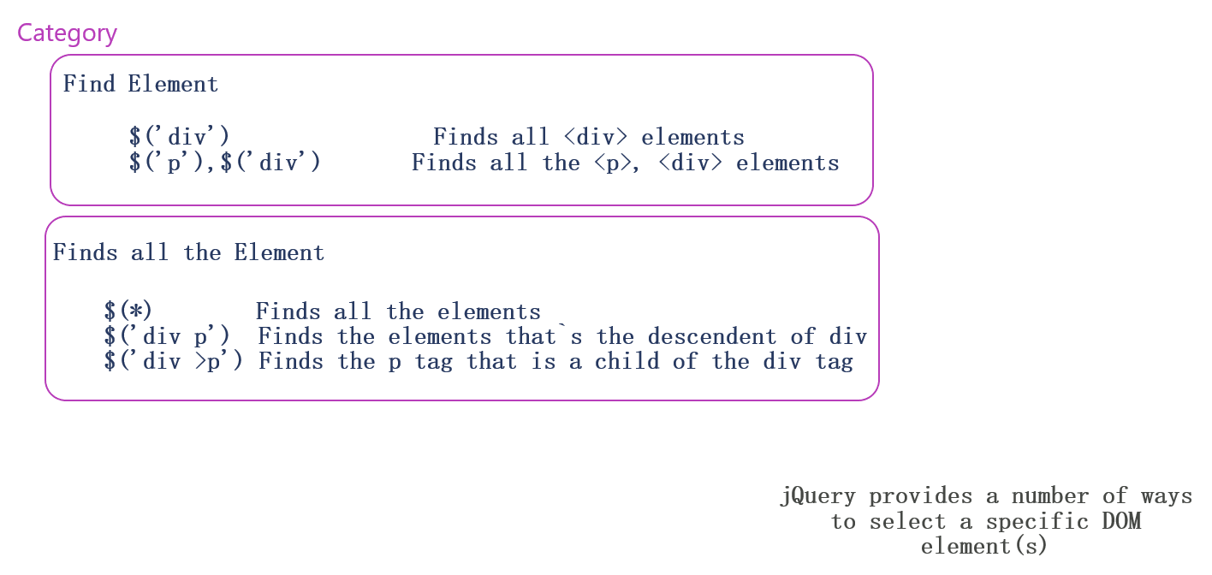
jQuery Selector Patterns

Slide 8
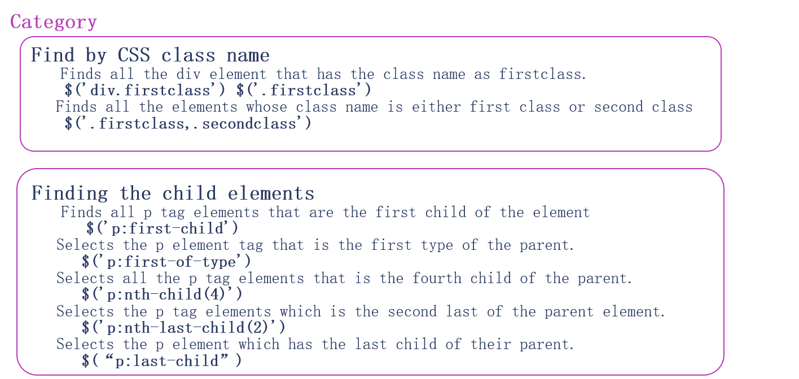
jQuery Selector Patterns

Slide 9
5.3 jQuery Effects
- Javascript Library
Lavanya Seetharaman
Instructor@BoardInfinity

Slide 10
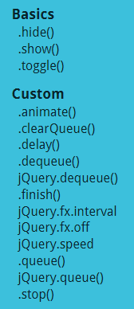
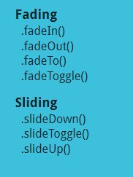
jQuery Effects
The jQuery library provides several techniques for adding animation to a web page. These include simple, standard animations that are frequently used, and the ability to craft sophisticated custom effects.
These effects takes parameters such as:
Speed – This defines how fast or slow the animation effect should be. Either it can be mentioned as “Slow” , “Normal”, “Fast” or in milliseconds (1000,2000)
Callback function – It is a custom function that can be applied to add in extra effects as needed or if needed. This function is completely optional.
Code Snippets:
$("#demo").hide(); // sets to display: none
$("#demo").show(200); // shows hidden element with animation (speed)
$("#demo").toggle(); // toggle between show and hide
$( "#element" ).hide( "slow", function() {
// hide with callback function
console.log( "Animation complete." );
});

Slide 11
jQuery Events
These methods are used to register behaviors to take effect when the user interacts with the browser, and to further manipulate those registered behaviors.
Browser Events
Document Loading
Event Handler Attachment
Mouse Events
Event Object
Form Events
Keyboard Events
Get jQuery Syntax : https://j11y.io/jquery/#v=1.11.2&fn=

Slide 12
jQuery Events
.on()
.off()
.one()
.proxy()
.trigger()
.triggerHandler()
.click()
.contextMenu()
.dblclick()
.hover()
.mousedown()
.mouseenter()
.mouseleave()
.mousemove()
.mouseover()
.mouseup()
.ready()
.resize()
.scroll()
Browser Events
Document Loading
Event Handler Attachment
Mouse Events
Event Object
Form Events
Keyboard Events
.event.currentTarget
.event.delegateTarget
.event.data
.event.preventDefault()
…..
.blur()
.change()
.focus()
.focusin()
.focusout()
.select()
.submit()
.keydown()
.keypress()
.keyup()

Slide 13
5.4 jQuery Traversing
- Javascript Library
Lavanya Seetharaman
Instructor@BoardInfinity

Slide 14
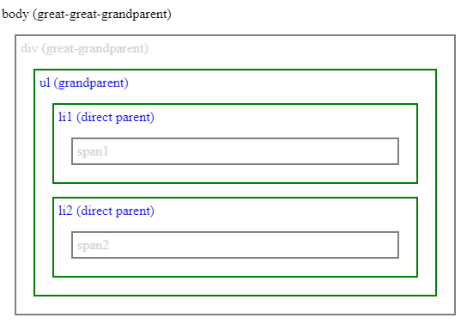
jQuery Traversing
jQuery traversing refers to a process of moving through the DOM to find specific HTML elements.
This search depends on the relations between elements.
jQuery provides multiple methods for traversing the DOM conveniently and dynamically.
Traversing Ancestors
When traversing upwards, jQuery provides these methods:
.parent(): return direct parent and traverse one level up the DOM tree.
.parents(): return all ancestors up to the root, can filter the search.
.parentsUntil(): return all ancestors in between two specified elements.

Slide 15
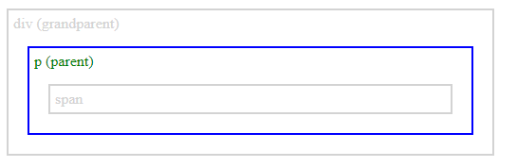
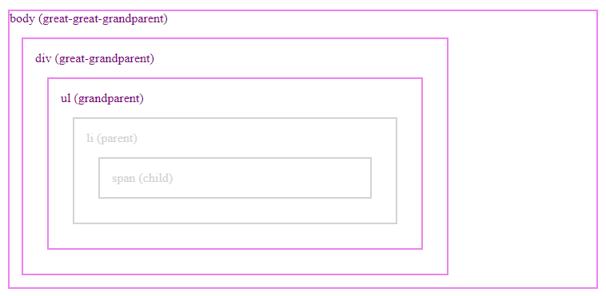
Traversing Ancestors
.parent()
you can traverse one level up the DOM tree and return the direct parent of a specified element. It is also possible to add a selector expression ($()). Then, the specified elements are filtered to find matches.
$(selector).parent([filter])
$("span").parent().css({
"color": "green",
"border": "2px solid blue"
});
.parents()
function returns all ancestors of the specified element up the root. Just like in the previous method, you can add a selector to find specific matches.
$(selector).parents([filter])
$("li").parents().css({
"color": "purple",
"border": "2px solid violet"
});

Slide 16
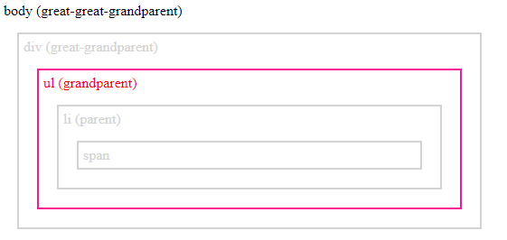
Traversing Ancestors
.parentsUntil()
returns all ancestors of the specified element up the root. You can add a selector for this function. If method traverses successfully (finds a match), the jQuery object will be generated. It will consist of all ancestors up to the match (won't include the actual match).
$(selector).parentsUntil([selector],[filter])
$("li").parentsUntil("div").css({
"color": "red",
"border": "2px solid deeppink"
});

Slide 17
jQuery Exercises
Your Turn
Part 1
Build a list page where users can add and rate examples from a category (e.g. movies, albums, or sports). This page should include the following:
A form, where you can add something to the list and rate it.
A table of all of the things you've added.
A delete button for each row of the table that lets you remove elements from the list.
Note: All DOM manipulation should be done using jQuery - don't use any vanilla JavaScript properties or methods to interact with the DOM!

Slide 18
jQuery Exercises
Your Turn
Now that you have learned a bit of jQuery, it's time to refactor an application from vanilla JS to use jQuery!
You can use an application that you have built previously, like the Todo application.

Slide 19
5.5 jQuery AJAX
- Javascript Library
Lavanya Seetharaman
Instructor@BoardInfinity

Slide 20
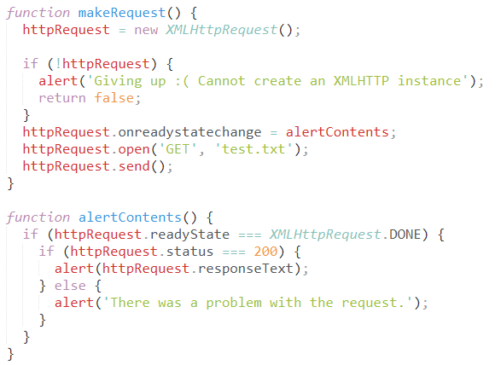
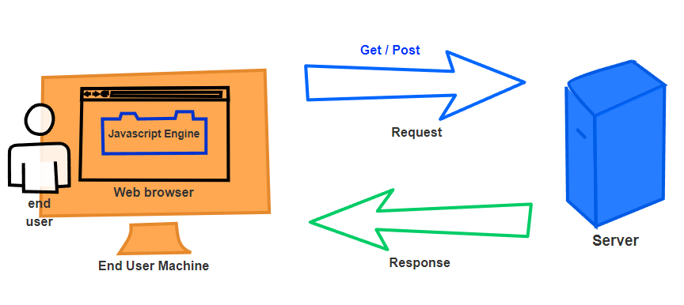
jQuery - AJAX
HTTP - Hypertext Transfer Protocol
How do I see my requests?
XHR - XMLHttpRequest
Notes:
https://www.airpair.com/js/jquery-ajax-post-tutorial

Slide 21
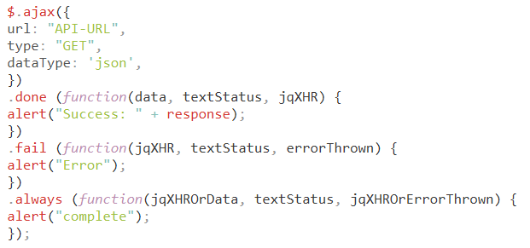
jQuery - AJAX Methods
jQuery Ajax HTTP GET or DELETE Method

